Slide 1
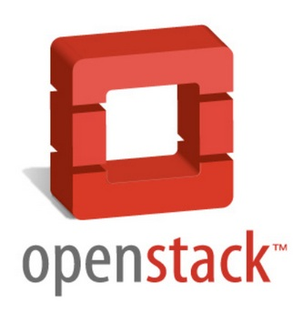
TurbaTech

Slide 2
What is OpenStack
Open source cloud servers software
Provides scalable, elastic cloud computing for both public and private clouds of all sizes
Simple to implement massively scalable

Slide 3







Community
153 participating companies
Over 2,300 developers in 12 countries

Slide 4
Compute
Nova Is a cloud computing fabric controller
Nova design principles:
  Component based
  Highly available
  Fault-tolerant
  Recoverable
Nova does a majority of the work for OpenStack

Slide 5
Object Store
Swift uses the Sphinx toolkit to cheaply, efficiently, and safely store tons of data

Slide 6
Image Service
Glance provides services for discovering, registering, and retrieving virtual machine images
Glance uses VM image metadata as well as retrieval of the actual image
  VM images made through Glance can be stored in a variety of locations

Slide 7
Authentication Middleware
Keystone provides identity, token, catalog, and policy services for use by openstack

Slide 8
Demonstration

